Slide 1
Mid Semester Review Session
M K Hamirwasia
WILPD

Slide 2
AE ZG523/DE ZG523/ES ZG523/MM ZG523/POM ZG523-Merged
Project Management
Session 11

Slide 3
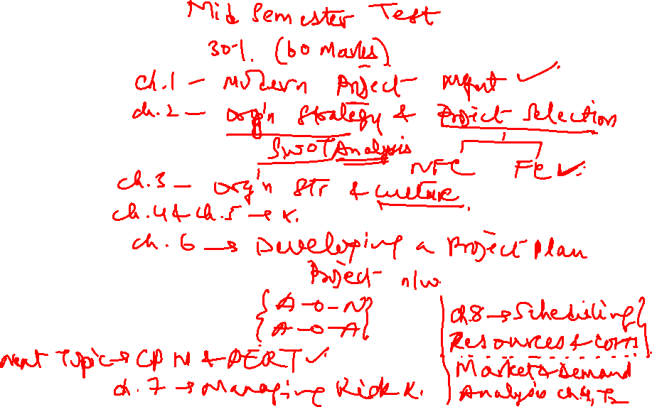

Slide 4
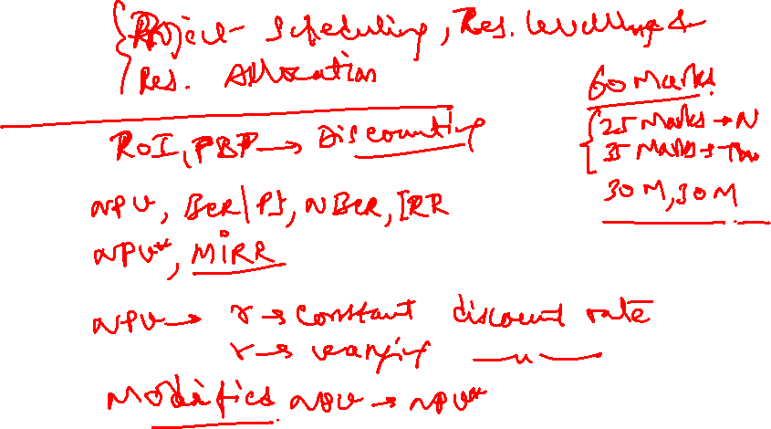

Slide 5
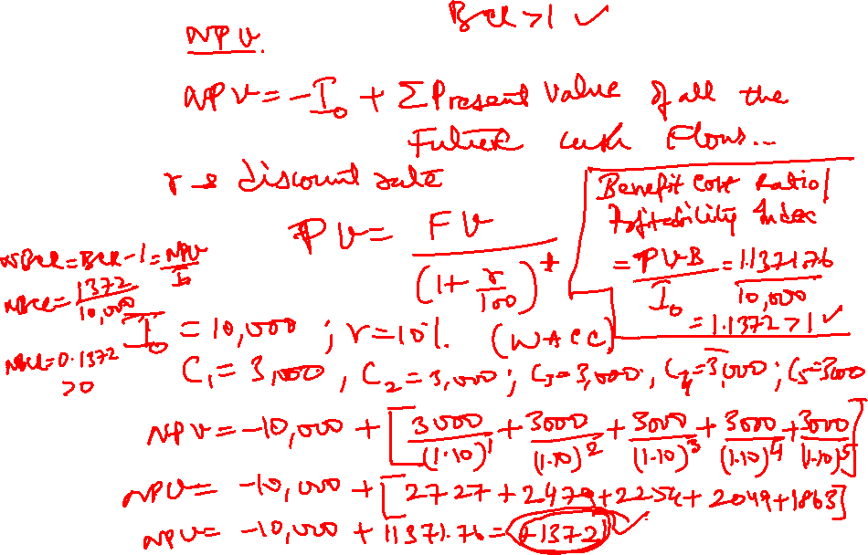

Slide 6
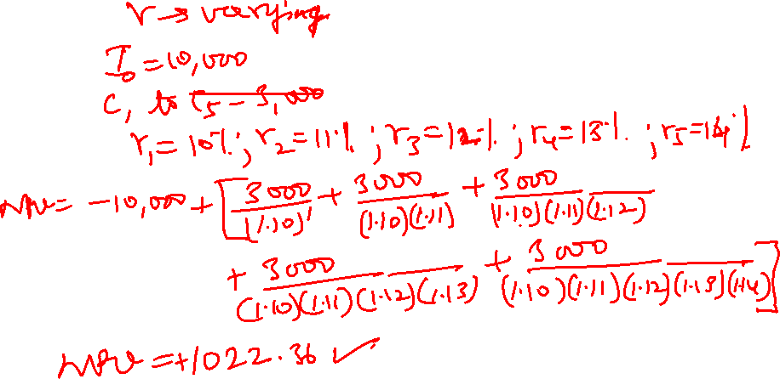

Slide 7
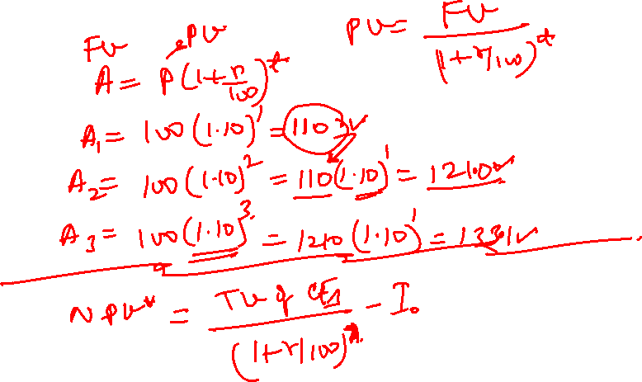

Slide 8
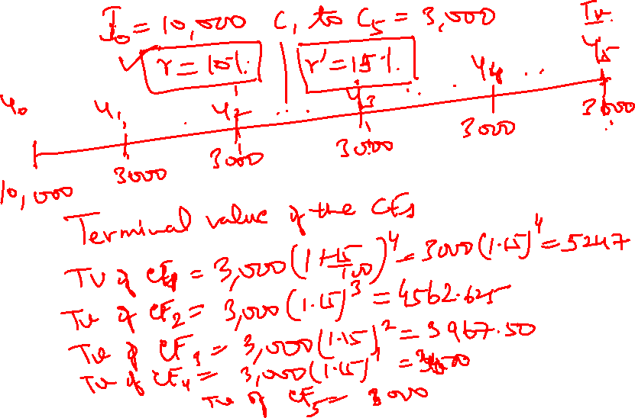

Slide 9
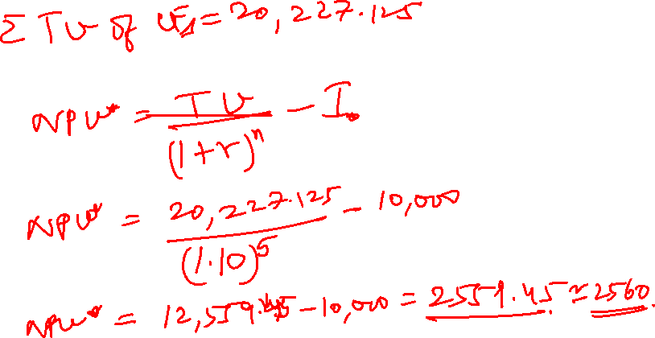

Slide 10
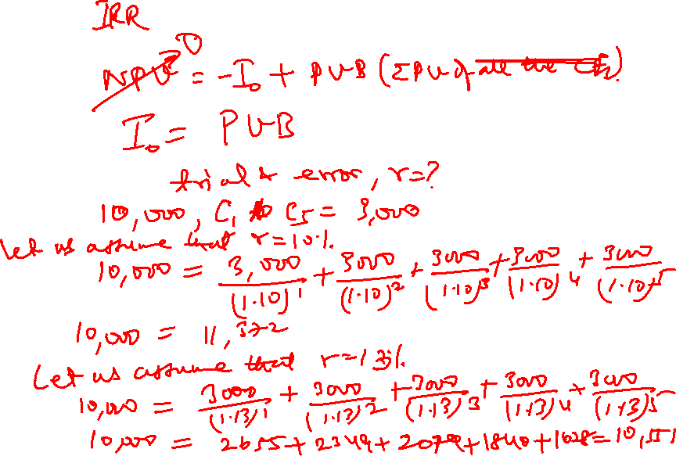

Slide 11
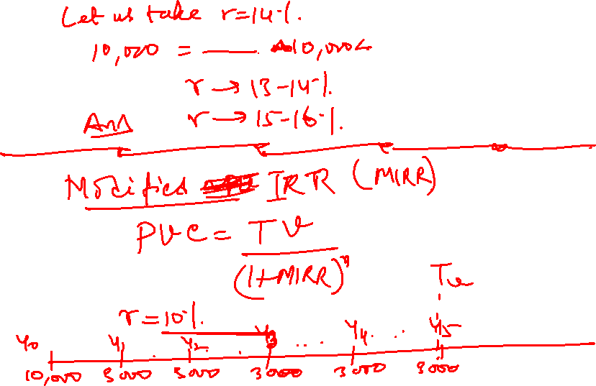

Slide 12
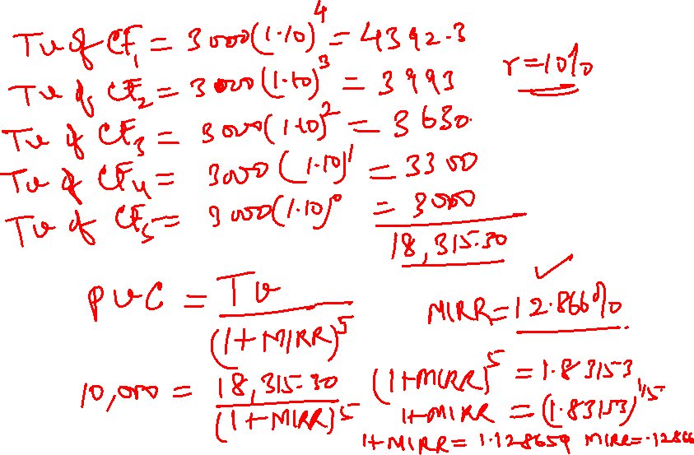

Slide 13
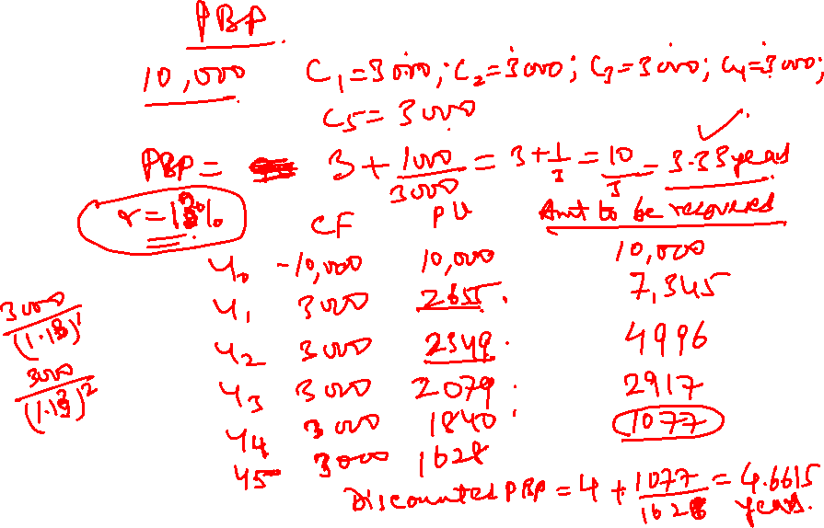

Slide 14
RESOURCE SCHEDULING, LEVELING & ALLOCATION
A housing project consists of activities as listed in the table. Compute the cement requirement based on early start and late start times. Also prepare a graph for cumulative cement requirement. What is the minimum and maximum requirements of cement up to the 8th week:

Slide 15
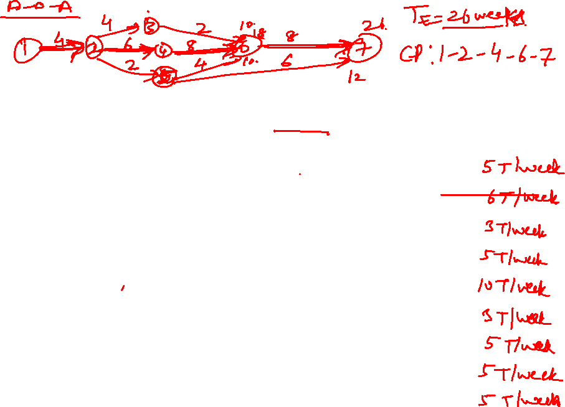

Activity | Duration in Weeks | Total Cement Required in Tons per activity
1-2 | 4 | 20
2-3 | 4 | 24
2-4 | 6 | 18
2-5 | 2 | 10
3-6 | 2 | 20
4-6 | 8 | 24
5-6 | 4 | 20
5-7 | 6 | 30
6-7 | 8 | 40

Slide 16

Level the resources
Allocate the resources if there is a constraint of 10 T of cement available per week and also find the duration of the project?

Slide 17
3
6
7
1
2
4
5

Slide 18
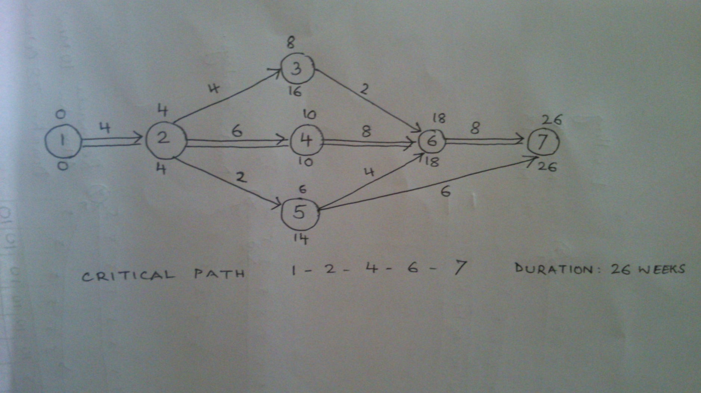

Slide 19
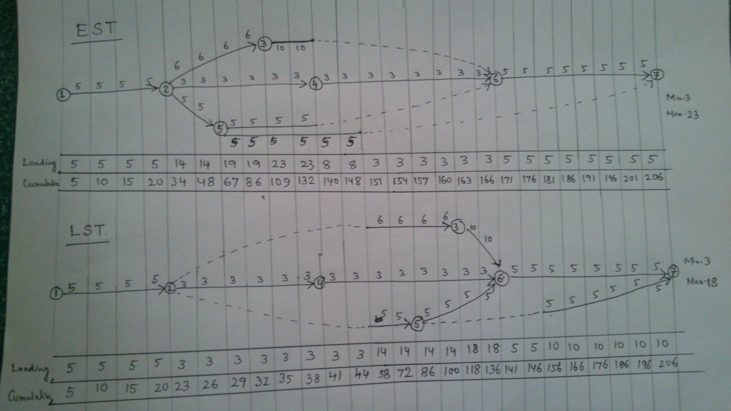
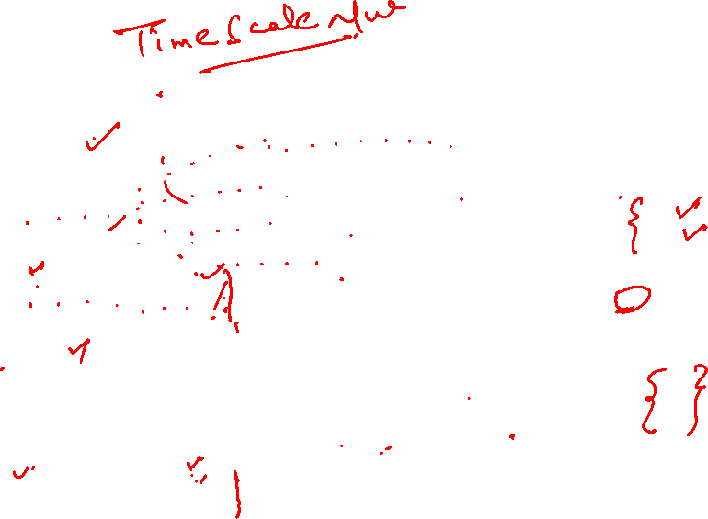

Slide 20
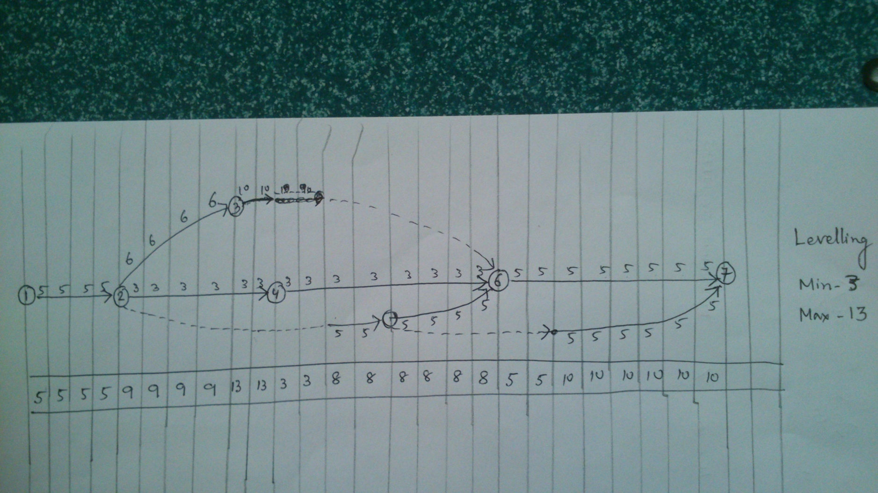


Slide 21
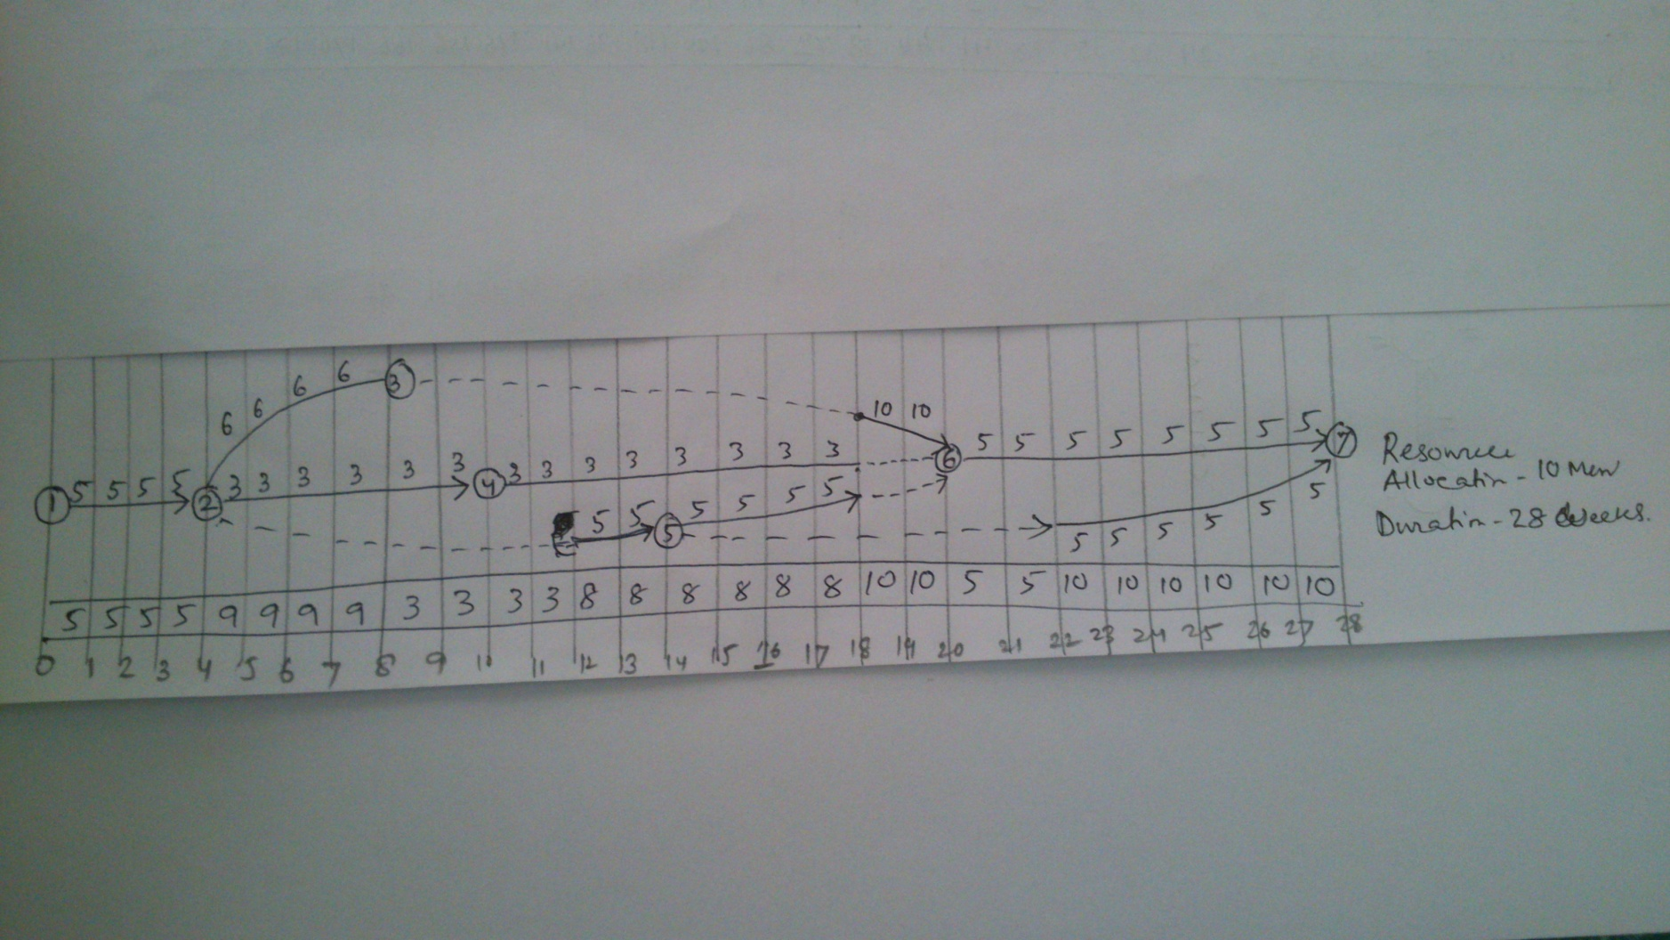


Slide 22
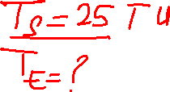
Exercise 2
The expected times and variances for the project activities are given below. What is the probability of completing the project in 25 periods?

Slide 23
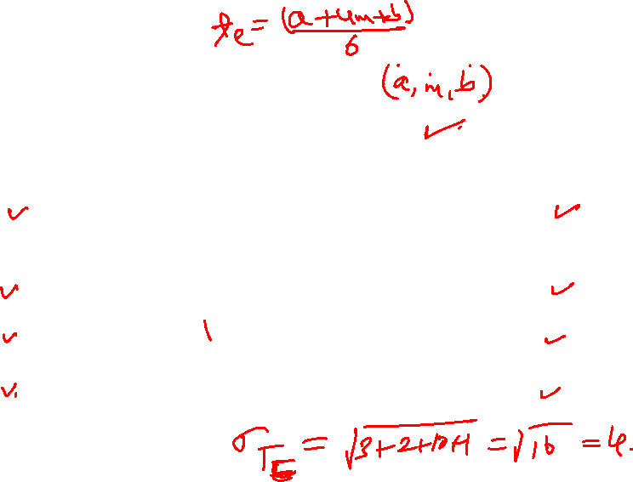
Exercise 2

Slide 24
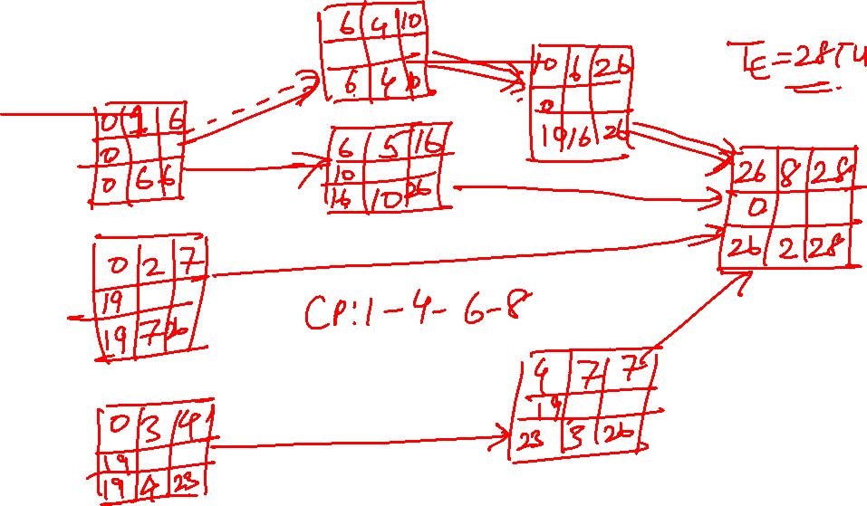

Slide 25
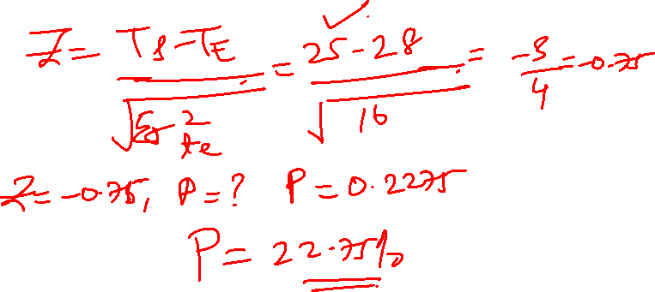

Slide 26
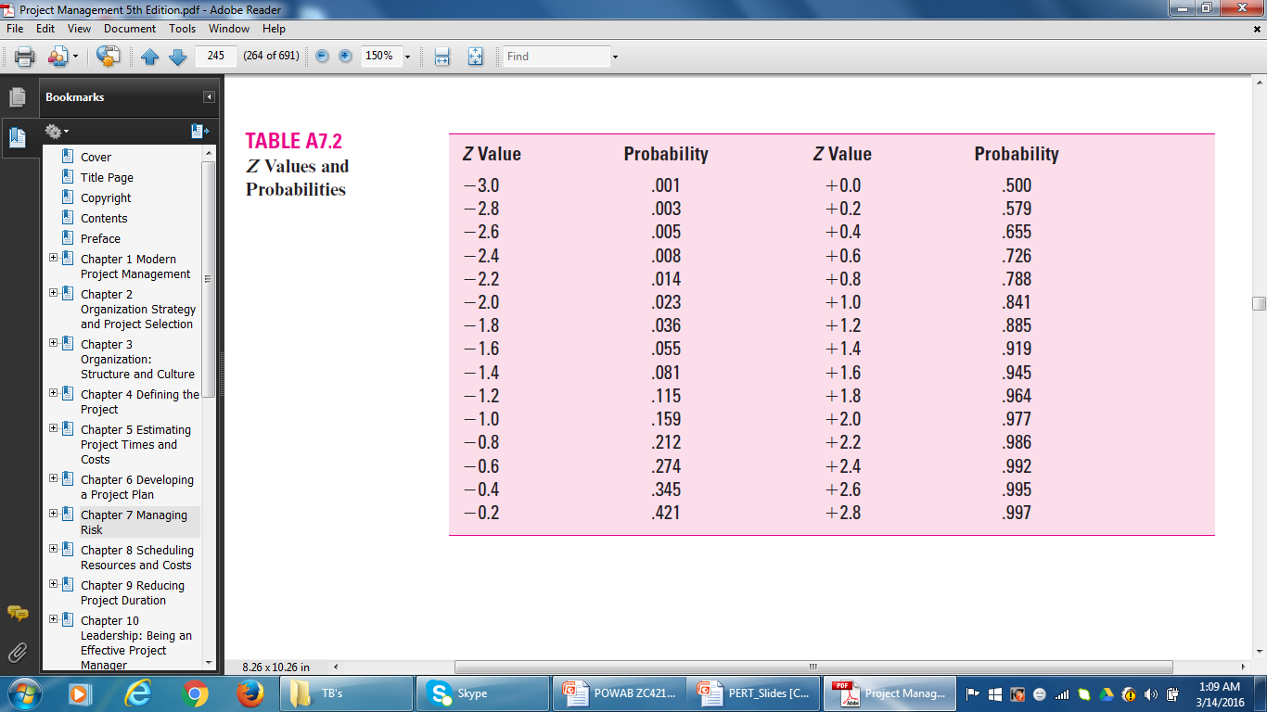
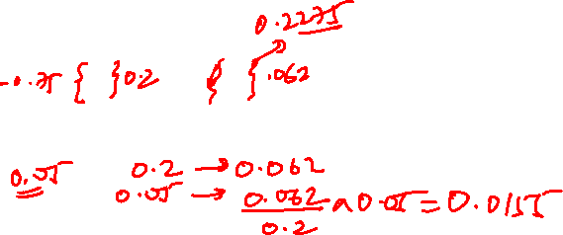
Z Values and Probabilities

Slide 27
A-O-N
6 | 4 | 10
0 | TM
6 | 4 | 10
10 | 6 | 26
0 | FP
10 | 16 |  | 26
0 | 1 | 6
0 | PP
0 | 6 | 6
6 | 5 | 16
10 | Patent
16 | 10 |  | 26
26 | 8 | 28
0 | Release
26 | 2 | 28
0 | 2 |  | 7
19 | SCD
19 | 7 | 26
4 | 7 | 7
19 | Ad Pr
23 | 3 | 26
0 | 3 |  | 4
19 | DMP
19 | 4 | 23
CP: 1-4-6-8
T_{E} = 28

Slide 28
A-O-N
  CP: 1-4-6-8
  σT_{E} = √ ∑ (σt_{e} )² = √3+2+10+1 = √ 16 = 4
  Z = TS – TE = 25 - 28 = - 0.75
σ_{TE} √16
P = 0.2275 (22.75 percent)

Slide 29
Project Management
All the Best!
M K Hamirwasia

